Slide 1
Violence prevention as peacebuilding in post-conflict states: the case of the Salvadoran Gang Truce
Kari Mariska Pries, PhD Researcher
University of Glasgow, UK

Slide 2


Acknowledgements
This research project is funded by the University of Glasgow through a doctoral research scholarship
Material support in the field has been generously provided by the International Organization for Migration (IOM) El Salvador and its Chief of Mission, Don. Norberto Giron

Slide 3
Overview
March 2012 (2)
Salvadoran Gangs in the Public Eye (2)
  Twenty-first Century Gang Policy: 2003-2008
  Changing of the Guard: 2009 Presidential Elections and the FMLN Policy Shift
Security and Prevention Policy Priorities: 2009-2012 (2)
Negotiating a Truce, Creating Spaces for Prevention (3)
Obfuscation and Narrative: What is real? (3)
Weaknesses of an Unclaimed Peace (3)
Conclusions

Slide 4
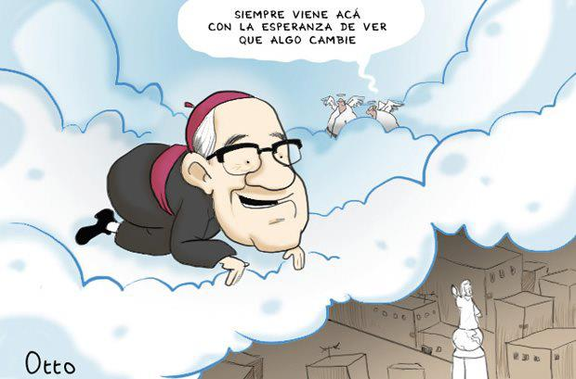
March 2012

Slide 5
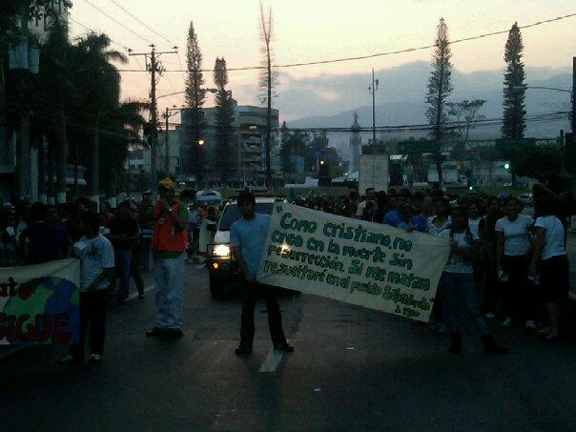
March 2012: The dawning of a new day without death

Slide 6
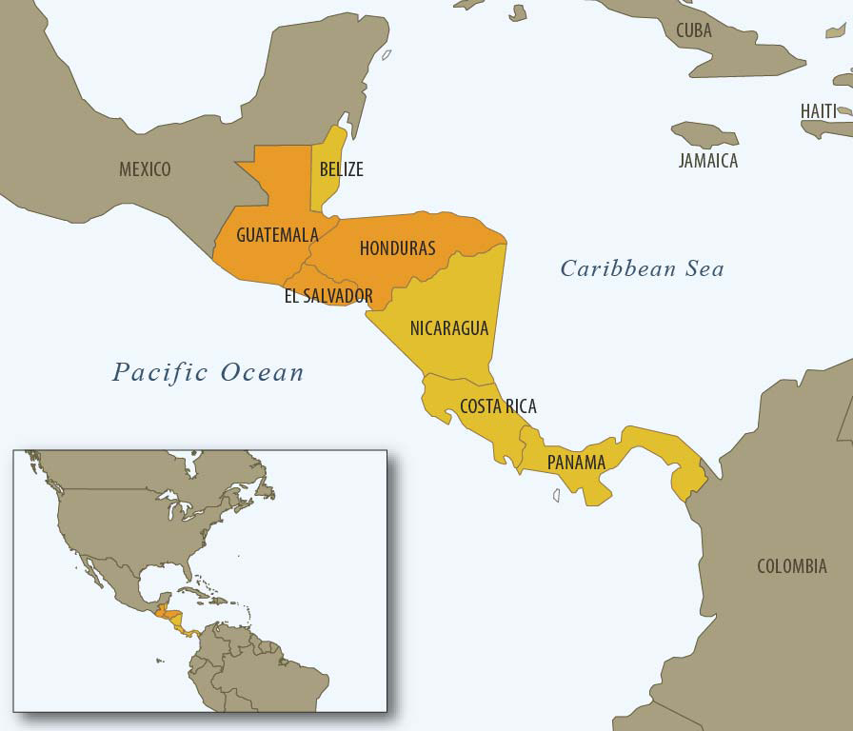

Slide 7
Salvadoran Gangs in the Public Eye
Civil War and Peacebuilding
Mapping Change: Security Policy
Peace Accords, demobilisation, institution strengthening
“Discovery” of gangs, criminality and the re-coding of violence
Anti-gang policies: Mano Dura, Super Mano Dura and political expediency
Changing of the Guard: New government, new ideology, unchanged priorities?

Slide 8
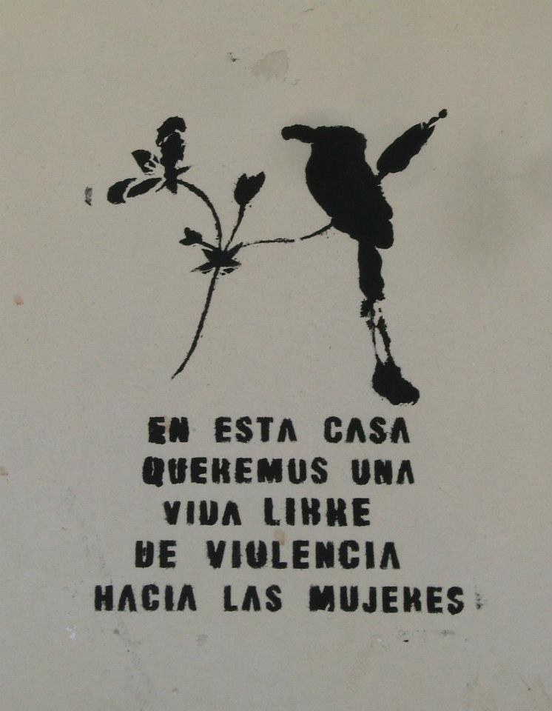
Security and Violence Prevention: 2009 - 2012
Prioritising crime and violence indicators rather than long-term solutioning
Capacity of government institutions to implement programmes limited
Combatting crime v. Preventing crime
Clinging to old habits (Mano Dura) as politically popular in the polls
Greater grassroots inclusion and locally-implemented programmes demonstrate some level of ideological switch (citizen security)

Slide 9
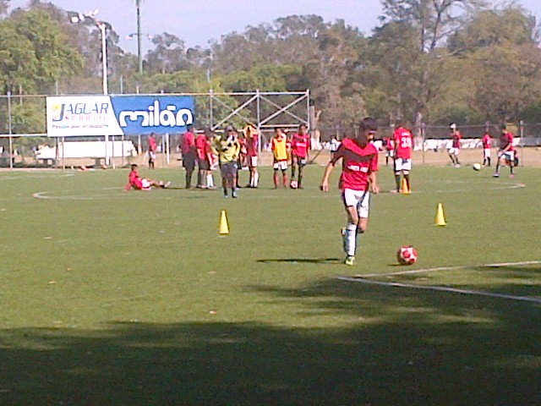
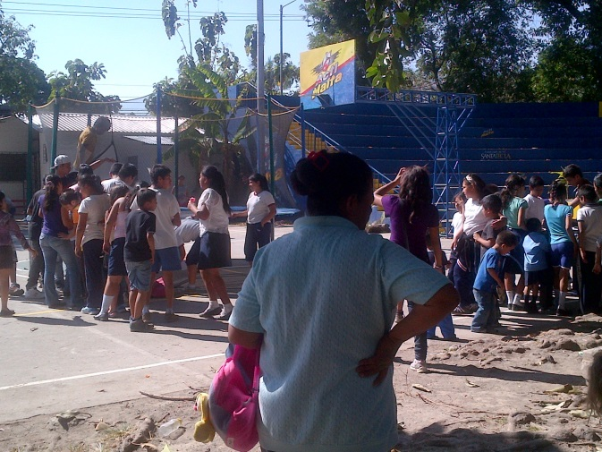
Negotiating a Truce, Creating Space for Prevention
Truce negotiated between two main gangs, MS-13, M-18, ostensibly facilitated by independent individuals
Despite lack of clarity, successful decrease in homicides leads to opportunity for programming implementation
Cities without Violence creating space for change
Despite success, individual citizens, government institutions and the international community remain unsold on potential
The window is closing…

Slide 10
Obfuscation and Narrative: What is real?
Who is involved in negotiation?
  Gangs and Facilitators: With government knowledge or with out?
  Gangs, Facilitators and government personnel: legally or illegally?
From whom did the idea of a Truce originate?
  Facilitators
  Gangs
  Government officials
  FMLN party strategy
What were the terms / what candies were promised in return for peace?
Did the government “negotiate with terrorists”?
Are gang members / gang leadership now political actors?

Slide 11
Weaknesses of an Unclaimed Peace
Public distrust in a shadowy process
  Fear of long-term planning or program spending for processes that will not last
  Inherent distrust of gangs and government
Lack of firm, distinct and courageous leadership
Political right / left divisions politicising process: Can truces with political allegiances last?
Danger of gangs as political actors: murders become political currency?
Upcoming March 2014 presidential elections compromising truce with allegations of promises and deals
Lack of international support, excepting OAS, because:
  Problem of dialoguing with criminals/terrorists
  Shareholder perceptions regarding criminals / prisons

Slide 12
Conclusion

Slide 13
THANK YOU
Kari Mariska Pries
University of Glasgow, UK
kari.mariska@gmail.com ; k.pries.1@research.gla.ac.uk

