Slide 1


The SICA Security Strategy
Kari Mariska Pries

Slide 2
Overview
Security Strategy Beginnings
Components
Implementation, Monitoring and Sponsorship
Strengths and Weaknesses

Slide 3
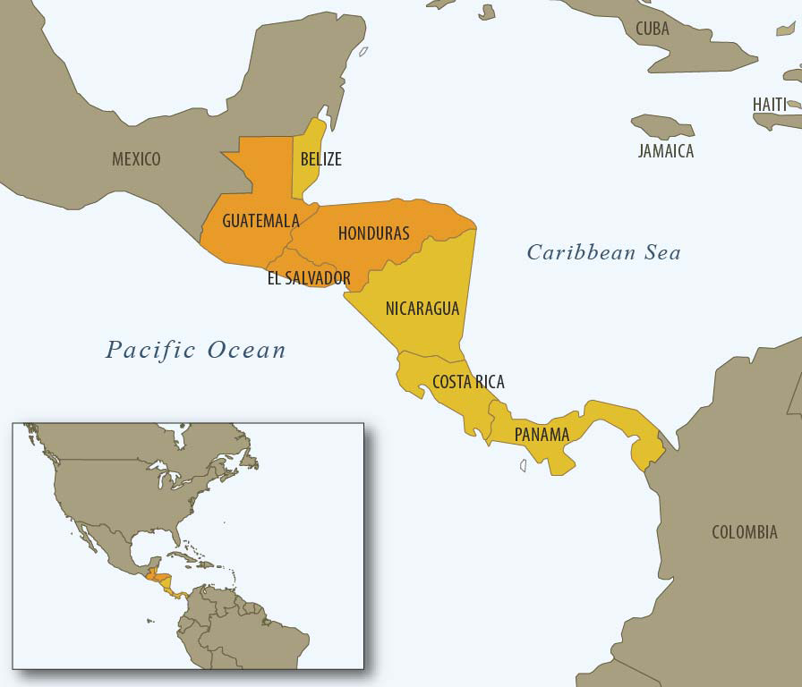

Slide 4
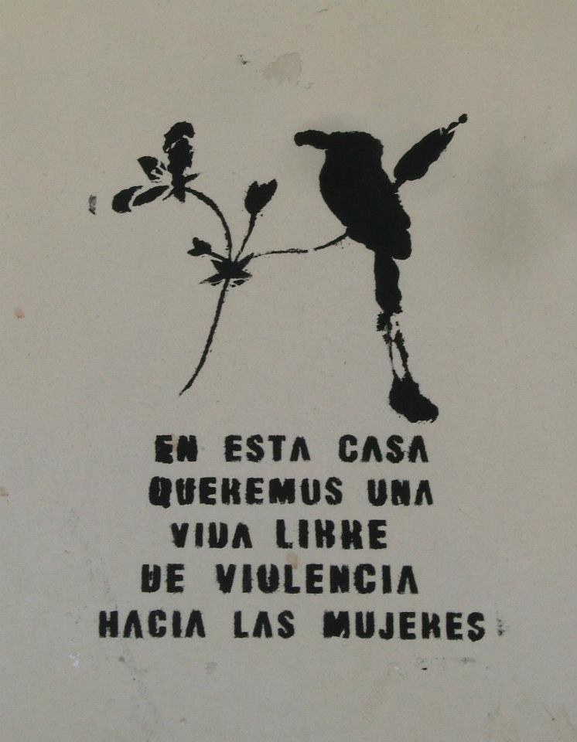
Unique, blurred security environment
Struggling for a decade with situation other violent zones only acknowledging now: Complex Security
National/Territorial, Citizen, Individual

Slide 5
Central America: Calling on the Regional Identity in a “New” Way
The Central American Security Strategy marks the beginning of a new step in the efforts to consolidate Central America as a secure region, in peace, liberty, democracy and development, so with this conviction, the Strategy was adopted, committing to its implementation. (Central American Security Strategy, 2011)

Slide 6
Structure and Approach: “New”
SICA:
Defining Priorities
Issue: Security
National Security Policies
Needs: Capacity, Funding
Traditional
CASS
Call for Proposals ($$)
Country
IO
NGO
Bank
Implementing Agency
Specific Project:
Independent
Specific Project:
Group
Country
Specific Project:
Independent or Group
System Development: Institution Strengthening, Materials etc.
International Community

Slide 7
Ownership and Consolidation
Initiation
Development
Means of Achieving Results – Agreement on Issues
Presentation to the International Community
“This is our baby, our child. All has been planned by the countries who suffered for this. We identified problems and proposed projects that will aid in the solutions. The process is ours...we did not contract consultants because we the countries have good experts. […] Central America has discovered its incredible expert resources – not in theory but in practices” (MJSP1, 2012).

Slide 8
Strategy Components
Combating Crime
Prevention
Rehabilitation, Reinsertion and Prison Security
Institution Strengthening

Slide 9
Initial Projects
AB1: Border Security (Also through SEFRO)
AC1: Criminal Investigations
AC5: Exchange of Information Technology Platform
[BA1: Prevention of Violence Against Women in CA]
BB1: Prevention of Youth Violence
BE1: Prevention from Local Government Perspective
CA1: Modernisation of Penal Systems
DB1*: Professionalization and Technologi-fication of Police Forces
DB2*: Modernisation of National Security Institutions with a Regional Security Vision (“Mother of the Strategy”) – Police, Fiscalia, Justicia
*Currently running

Slide 10
Participants
  SICA Directorate, Secretary General, Member Countries
  Friends (IOs): USAID, UNDP, UNODC, UNOCHR, IOM, OAS
  Friends (Banks): IADB, WB, BCIE
  Friends (Countries): US (USAID), Germany (GiZ), Spain (Fundo España), Italy, Chile, Mexico, Australia, Canada (CECI), Colombia, South Korea, Japan, Israel, Georgia, [also UK, Norway, Sweden, Finland, Netherlands]

Slide 11
Projects Grouped in 3 Priorities
Strengthening Institutional Capacities
Technology and Training in Border Security
Technological, Equipment and Information Systems for Improved Prevention Capacities

Slide 12
Monitoring and Sponsorship: International Community Trends
European
North American
Integration
Sponsorship through SICA (Spain located IN the SICA)
Prevention-driven
Bi-lateral
Sponsorship of Individual Implementing Parties
Enforcement-driven

Slide 13
Conflicting Perceptions
Money and Control
Strategy Structure Changeability
Initial Project Development
Member Country Continuing Distrust
Expectations of SICA
Policy, Strategy, Collection of Projects?

Slide 14
Conclusions
Importance of Coordinated Regional Action
Some flexibility has been created over the last 12 months
SICA: 2013 Staffing - Component Coordinators and Specialists (Gender, Justice, Planning, Monitoring and Evaluation) (Spain Financing)
Issue with “new” approach and traditional donorship (despite Paris)
Case in Point: November Washington Meeting
  Cancelled over information control struggle, lack of advances on both sides (monetary commitments, project flexibilisation)

Slide 15
Questions?
Thank You!
Kari Mariska Pries
kari.mariska@gmail.com
k.pries.1@research.gla.ac.uk
kpries@iom.int

