Slide 1
Challenged National Sovereignty, Regional Coordination, and the Reality of Global Influence
Kari Mariska Pries
k.pries.1@research.gla.ac.uk

Slide 2
Outline
Challenge to National Sovereignty: Insecurity in the Central American Isthmus
The Problem: Insecurity
The Question: Can Security Form a Basis for greater Central American Regionalisation*?
The Proposal: Central American Security Strategy (ESCA)
Challenges in Execution: Macro
Challenges in Execution: Micro
Regionalism in Security and Competing International Visions: Influences
Conclusion
* Regionalisation stands in for the Regional Continuum of coordination / collaboration / integration

Slide 3
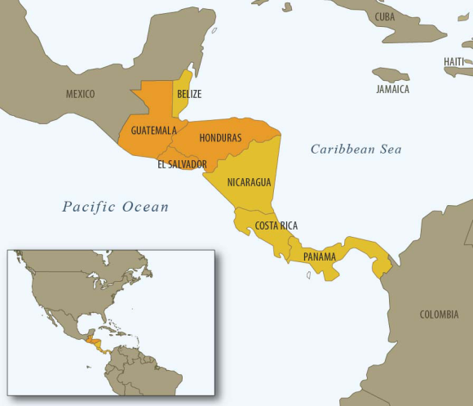
The Problem: Insecurity
Unique, Blurred Security Environment
  Struggling for a decade with situation other violent zones only acknowledging now: Complex Security
  National / Territorial, Citizen, Individual
States failing to address internal and transnational security threats
Internationally funded project and programmes challenged by limited effectiveness, duplication of efforts, long-term visioning

Slide 4
The Question: Can Security Form a Basis for Central American Regionalisation?
Regionalism: Structured Cooperation/Collaboration/Integration (Regionalisation Continuum) in a given geographic area (Central America) requiring “supranationalization of authority in a given policy field, which requires some degree of shared sovereignty” (Fioramonti 2012, 4)
The Role of Crisis in Regionalisation
Central America is employing the “Regionalisation Continuum” in order to address unstable domestic circumstances AND to (re)capture autonomy / increase authority on the international stage
  Challenges: State-centric nature of Latin America; Political nature of security especially as related to power, governance and elections; General weakness of state institutions leading to weak regional institutions; Usual failure of regional integration efforts

Slide 5
The Proposal: central America Security Strategy (ESCA)
Regional Identity and the Central American Integration System (SICA)
  Pursuit of “security” through joint efforts of Central American states unique but falls into historical pattern
  Lack of national successes triggering “binary identity”:
“[A] national and regional identity in which the latter is activated once national problems cannot be dealt with domestically […where] the inability of a country to find solutions to an issue at the national level may trigger the regional identity and thus lead it to search for answers at the bilateral or regional level.” (Caballero 2009, 56)
  “With the growing transnational character of organised crime activities in SICA countries and with the rising wave of violence in the region, it was necessary to revise the Strategy adopted in 2007, and this time involving all sectors of society in collaboration with international cooperation, countries and multilateral institutions.” (SICA 2011)
  ESCA adopted in Guatemala City 22 June 2011
  “To establish the necessary components and activities in Central America to strengthen the security of persons and property which allows our people to achieve human development goals.” (SICA 2011)

Slide 6
The Proposal: central America Security Strategy (ESCA) I – Ownership
“This is our baby, our child. All has been planned by the countries who suffered for this. We identified problems and proposed projects that will aid in the solutions. The process is ours...we did not contract consultants because we the countries have good experts. […] Central America has discovered its incredible expert resources – not in theory but in practices” (MJSP1, 2012).
Initiation
Development
Means of Achieving Results – Agreement on Issues
Presentation to the International Community

Slide 7
The Proposal: central America Security Strategy (ESCA) II – Structure
Traditional Approach
SICA:
Defining Priorities
Issue: Security
National Security Policies
Needs: Capacity, Funding
ESCA
Call for Proposals ($$)
Country
IO
NGO
Bank
Implementing Agency
Specific Project:
Independent
Specific Project:
Group
Country
Specific Project:
Independent or Group
System Development: Institution Strengthening, Materials etc.
International Community

Slide 8
The Proposal: Central America Security Strategy (ESCA) III – Pillars and Risk AS AGREED
Combating Crime
Prevention
Rehabilitation, Reinsertion and Prison Security
Institution Strengthening
AB1: Border Security (Also through SEFRO)
AC1: Criminal Investigations
AC5: Exchange of Information Technology Platform
[BA1: Prevention of Violence Against Women in CA]
BB1: Prevention of Youth Violence
BE1: Prevention from Local Government Perspective
CA1: Modernisation of Penal Systems
DB1*: Professionalization and Technologi-fication of Police Forces
DB2*: Modernisation of National Security Institutions with a Regional Security Vision (“Mother of the Strategy”) – Police, Fiscalia, Justicia
*Currently running

Slide 9
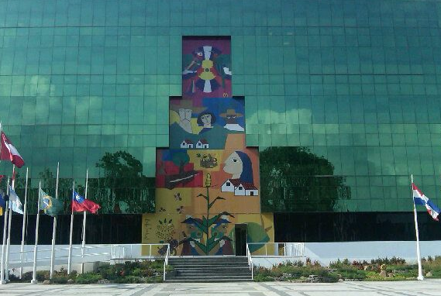
Challenges in Execution: Macro
Bilateral Relations between States
Reluctance to hand over authority to supranational organisation
The International Community, SICA Reliability, SICA Function (diplomatic not implementing body)

Slide 10
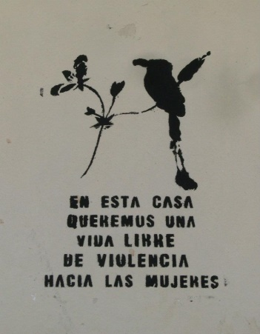
Challenges in Execution: Micro
Structure (“Pillars”) only represent issues which could be “agreed upon” by Member Countries, not necessarily greatest risks
Disagreements of the International Community and SICA over Financing, Monitoring and Evaluation
Lack of Regional Vision in Programme Implementation

Slide 11
Regionalisation in Security and Competing State Visions
A: Strategy Splinter
B: Operational Integration
Components developed through agreement, not negotiation
Local realities breakdown ESCA unity
Lack of buy-in from Police and Military for Regional Partnerships (not consulted)
Lack of support from certain international partnerships – especially with regards to SICA capacity
Country-driven process through regional cooperation
Contemplation of regional realities and experience similarities
Support of some international partnerships (EU, Spain, Germany)
Potential for project development including concrete indicators

Slide 12
Regionalism in Security and Competing International Visions
North America
Europe
Bi-lateral
Sponsorship of Individual Implementing Parties
Enforcement-driven
“We will work directly with partner countries, and partner agencies to implement. We are not in the position to provide money directly to SICA.”
CANADA: ACCBP (crime) / START (victims)
Integration
Sponsorship through SICA (Spain located IN the SICA)
Prevention-driven
“We participate and support the process because we have expertise to give and because we wish to act in solidarity.”
GERMANY (GiZ): PREVENIR
EU via SPAIN: SICA

Slide 13
Conclusions
Lack of supranational power delegation does not necessarily compromise regionalisation as Latin American regional projects do not follow theories formulated with respect to the European integration project
Central America integrating in order to address domestic and transnational insecurity as well as to re-capture autonomy and/or weight on the international stage
Regionalisation in this context also affords greater authority to government officials / executive branch and thus regional efforts (positives) feed back to the domestic level and do not provide significant space for opposition parties or civil society contributions
Lack of International By-in to the ESCA continues to significantly hinder the project and compromise the “regional character” of the strategy

